Slide 1
The Cardiovascular system & Physiology of
Heart

Slide 2
Content
Components of the cardiovascular system (CVS)
The systemic and pulmonary circulation
Basic functions of the various parts of the CVS.
General function of the CVS.
Physiological anatomy of the heart.
Blood vessels
Heart sounds
Characteristics of blood

Slide 3
Cardiovascular System
 In order to pump blood through the body,
the heart is connected to the vascular system
of the body.
 It is the closed system.
 It is designed to transport oxygen and
nutrients to the cells of the body and remove
carbon dioxide and metabolic waste products
from the body.

Slide 4
Components of CVS
Heart:
 It is a pump composed of 4 chambers (2 atria & 2 ventricles.
 The heart provides the driving force for the cardiovascular system.
Blood Vessels:
The blood vessels are systems of tubes including:
Arteries and arterioles which carry the blood from the heart to all parts of the body.
The arteries serve as distribution channels to the organs

Slide 5
Components of CVS
Venules and veins which carry the blood back from the tissues to the heart.
The veins serve as blood reservoirs and collect the blood to return it to the heart.
Blood capillaries which form a network of fine vessels connecting the arterioles with the Venules.
The blood capillaries are the sites of exchange of
gases (O2 & CO2), nutrients and waste products
between blood and tissues.

Slide 6
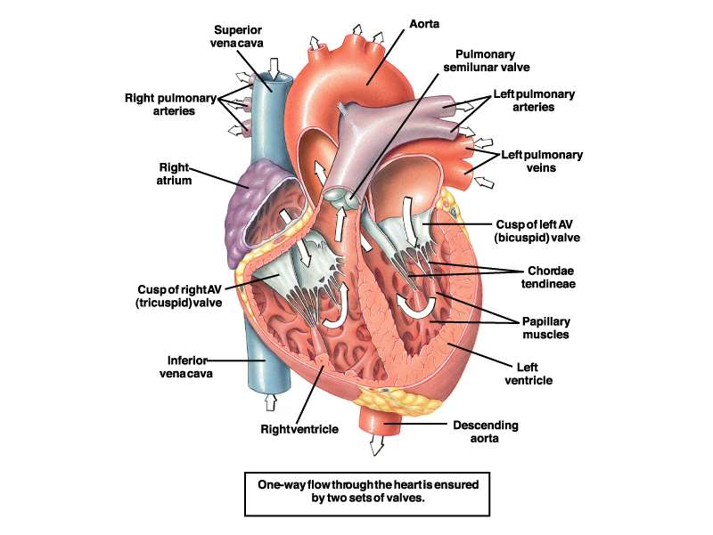
GENERAL STRUCTURE OF THE HEART
The heart is a hollow muscular organ. Its walls arecomposed of a muscle called the cardiac muscle or the myocardium

Slide 7
Construction of CVS
 The cardiovascular system is actually made up of two major circulatory systems, acting together.
 The right side of the heart pumps blood to the lungs through the pulmonary artery (PA), pulmonary capillaries, and then returns blood to the left atrium through the pulmonary veins (PV).
The left side of the heart pumps blood to the rest of the body through the aorta, arteries, arterioles, systemic capillaries, and then returns blood to the right atrium through the Venules and great veins

Slide 8
In the cardiovascular system, blood passes through;
two circulations in series. One full circulation consists of these two circulations together. Both circulations start and end in the heart. These two circulations are:
The systemic (or greater or high-pressure)circulation: It starts in the left ventricle → the aorta → systemic arteries → systemic capillaries → systemic veins →superior and inferior vena cava → ends in the right atrium.
The pulmonary (or lesser or low-pressure) circulation:
It starts in the right ventricle → the pulmonary trunk → pulmonary arteries → pulmonary capillaries →pulmonary veins → ends in the left atrium.

Slide 9
Cont’
❖
The two circulations are in series. So, blood finishes one circulation to start the other.
This allows the whole blood volume to carry out its respiratory function more efficiently as blood goes once through the systemic capillaries and once through the pulmonary capillaries.
Thus, both ventricles must pump the same volume of blood during any significant time interval because of the series arrangement of the systemic and pulmonary circulations.

Slide 10
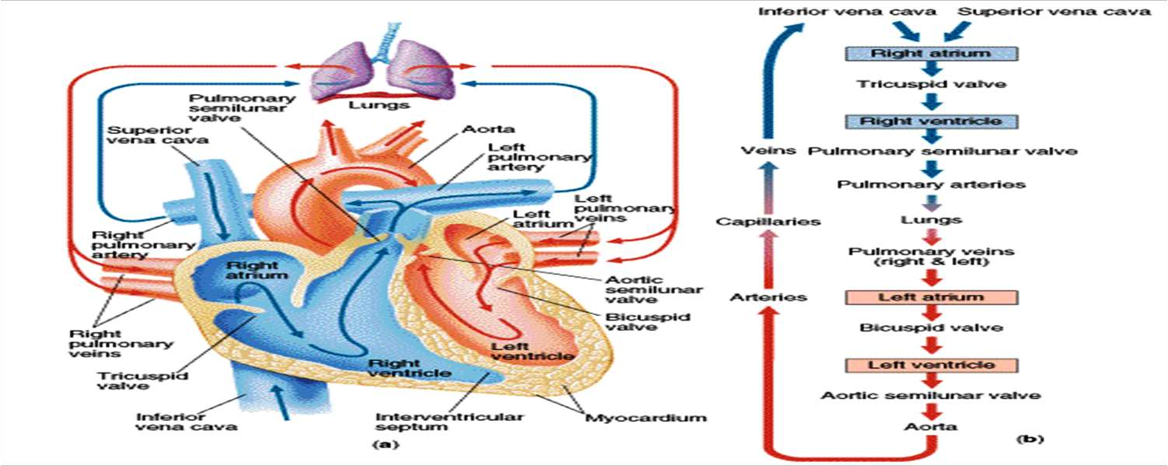
SYSTEMIC AND PULMONARY CIRCULATION

Slide 11
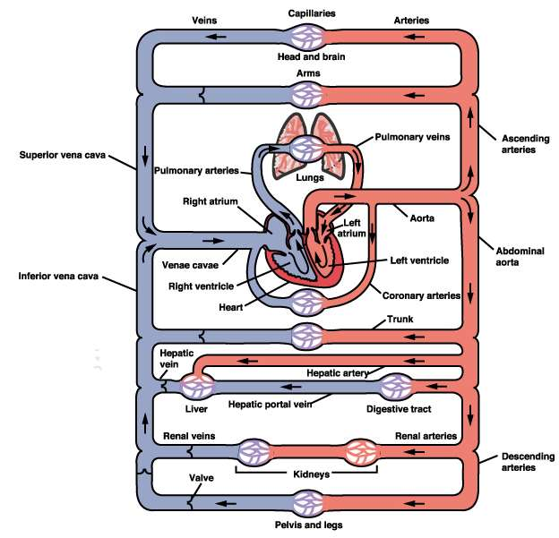

Slide 12
The HEART is the great central pump of the CVS.
It lies in the left side of the thoracic cavity partly behind the sternum
and between the right and left lungs.
It is covered by a fibrous sac called the pericardium.
Cardiac Chambers & their functions
The human HEART is consist of four chambers: 
Two atria (right and left) which are separated from each other by the interatrial septum.
Two ventricles (right and left) which are separated from
each other by the interventricular septum. 

Slide 13
- The semi lunar valves
Allow for the blood to pass from the ventricles into the arteries during ventricular systole.
During ventricular diastole, these valves prevent back flow of blood from the arteries into the ventricles (as these valves become closed during ventricular diastolea)
The valves open or close depending upon the pressure gradient of the blood on both sides of the valves e.g.
The AV valves:
- Open when the atrial pressure becomes higher than
the ventricular pressure or

Slide 14
The wall of the left ventricle is about 3 times thicker than the wall of the right ventricle.
The ventricular myocardium (wall) is much thicker and stronger than the atrial myocardium (wall). The atrial muscle (of both atria) is completely separated from the ventricular muscle (of both ventricles) by a fibrous ring called AV ring
(atrioventricular ring).
The atria have 2 main functions:
1) They act as blood reservoir for the blood returning
back to the heart.
2)They act as pumps (primer pumps).
Atrial contraction pushes about 25% of the blood filling
the ventricles during ventricular diastole and about
75% of the blood that ventricles during their
diastole pass passively i.e. by its own weight.

Slide 15
Two semi lunar valves:
- Aortic valve between the left ventricle and the aorta.
-Pulmonary valve between the right ventricle and the
pulmonary trunk.
Functions of the cardiac valves
Allow for the blood to pass only in one
direction i.e.
The AV valves allow for the blood to pass from the atria into
the ventricles during ventricular diastole. During ventricular
systole, the AV valves close to prevent back flow of blood from
the ventricles into the atria.

Slide 16
The ventricles,
Powerful cardiac pumps filling the arteries with blood.
The right ventricle (pulmonary pumps) pushes blood into the
pulmonary arteries and the left ventricle (systemic
pump) pushes blood into the aorta during ventricular
systole
The human heart contains four valves
Two atrioventricular valves (AV valves) between the
atria and the ventricles:
- Tricuspid valve between the right atrium and the right
ventricle.
- Mitral or tricuspid valve between the left atrium and
there left ventricle.
ardiac

Slide 17
CONT’
Close when the ventricular pressure becomes higher that the atrial pressure.
The semi lunar valves: Open when the ventricular pressure becomes higher
than the arterial pressure andClose when the arterial pressure becomes higher than the ventricular pressure.

Slide 18
The right ventricle
The right ventricle pumps relatively large volumes of blood at a low pressure through the pulmonary circulation (the right ventricle is essentially flow generator).
The normal cross-section of the right ventricle is crescent-shaped.
If the right ventricle must eject blood against a high pressure for prolonged periods (as seen in certain pulmonary diseases), it assumes a much more cylindrical appearance and there is a thickening of the right ventricular free wall (right ventricular hypertrophy).

Slide 19
The left ventricle
The left ventricle pumps blood through the systemic circulation.
It is cylindrical in shape and normally has a thicker wall than does the right ventricle.
❖
The left ventricle works much harder than the right ventricle because of the higher pressure in the systemic circulation (the left ventricle is essentially pressure generator).
Consequently, the left ventricle is more commonly affected by disease processes than is the right ventricle.

Slide 20
Blood flow from the heart
During ventricular systole, blood is pumped into the circulation.
During diastole, the pumping of blood stops and the ventricles get filled with blood.
In this way, the flow of blood from the ventricles into the systemic and pulmonary circulations is an intermittent pulsatile flow.
The heart rate is under neural control. Cardiac sympathetic efferent activity increases the heart rate, whereas parasympathetic (vagal) efferent impulses decreases heart rate. 

Slide 21
cont’
The heart of a normal adult male beats automatically and regularly at a rate of 75 beats/minute during rest. The normal range of heart rate is between 60 – 100.
The stroke volume for each ventricle averages 70 ml of blood, and a normal heart rate is approximately 70-75 beats/minute; therefore, the cardiac output at rest is approximately 5L/min

Slide 22
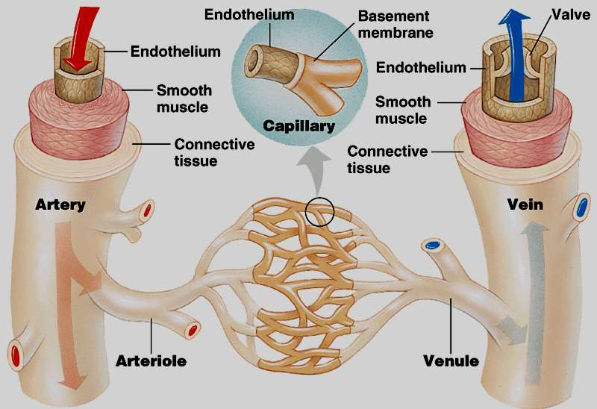
Blood vessels

Slide 23
Blood vessels
1. Elastic vessels.
2. Low-resistance vessels.
3. High-resistance vessels.
4. Exchange vessels.
5. Capacitance vessels.

Slide 24
The peripheral resistance
As the blood flows from the arterial to the venous side of the circulation, it meets resistance because of the smaller caliber of the vessels and the viscous nature of the blood. This is called the peripheral resistance.
It is an important factor in generating and maintaining the arterial blood pressure.
Vasoconstriction of the small vessels increases the peripheral resistance, which in turn elevates the arterial blood pressure. Whilst vasodilatation decreases the resistance and lowers the pressure.

Slide 25
cont’
The wall of the left ventricle is much thicker (15 mm) than the wall of the right ventricle (5 mm), yet the capacities and outputs of both ventricles are equal.
The thickness of the ventricular wall reflects the pressure load on the ventricle. The pressure load on the left ventricle (the aortic pressure) is much higher than the pressure load on the right ventricle (the pulmonary arterial pressure).

Slide 26
Heart Sounds
Heart sounds are the noises generated by the beating heart and the resultant flow of blood through it.
 Specifically, the sounds reflect the turbulence created when the heart valves snap shut.
In cardiac auscultation, an examiner may use a stethoscope to listen for these unique and distinct sounds that provide important auditory data regarding the condition of the heart.
In healthy adults, there are two normal heart sounds often described as a lub and a dub (or dup), that occur in sequence with each heartbeat.These are the first heart sound (S1) and second heart sound (S2), produced by the closing of the AV valves and semilunar valves, respectively

Slide 27
Functions and Characteristics of the Blood
Blood is the only liquid tissue in the body.
It is a connective tissue. Consists of formed elements (cells and cell fragments) in a liquid intercellular matrix (plasma)
Average adult blood volume is around 5 liters (8% of body weight)

Slide 28
Blood Functions
Transportation: Blood transports oxygen and nutrients to cells, CO2 and waste away from cells, hormones to target tissues
Regulation: Helps maintain stable body temperature, pH, water and electrolyte levels.
 Protection: Clotting prevents fluid loss, white blood cells protect body against disease

Slide 29
THANKYOU

